Slide 1
CS525: Special Topics in DBs Large-Scale Data Management
Hadoop/MapReduce Computing Paradigm
Spring 2013 WPI, Mohamed Eltabakh

Slide 2
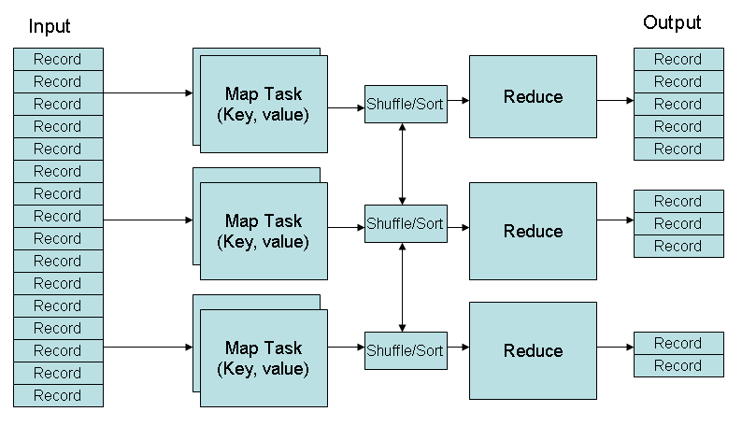
MapReduce Phases
Deciding on what will be the key and what will be the value ➔ developer’s responsibility

Slide 3
Key-Value Pairs
Mappers and Reducers are users’ code (provided functions)
Just need to obey the Key-Value pairs interface
Mappers:
Consume <key, value> pairs
Produce <key, value> pairs
Reducers:
Consume <key, <list of values>>
Produce <key, value>
Shuffling and Sorting:
Hidden phase between mappers and reducers
Groups all similar keys from all mappers, sorts and passes them to a certain reducer in the form of <key, <list of values>>

Slide 4
Processing Granularity
Mappers
Run on a record-by-record bases
Your code processes that record and may produce
Zero, one, or many outputs
Reducers
Run on a group-of-records bases (having same key)
Your code processes that group and may produce
Zero, one, or many outputs

Slide 5
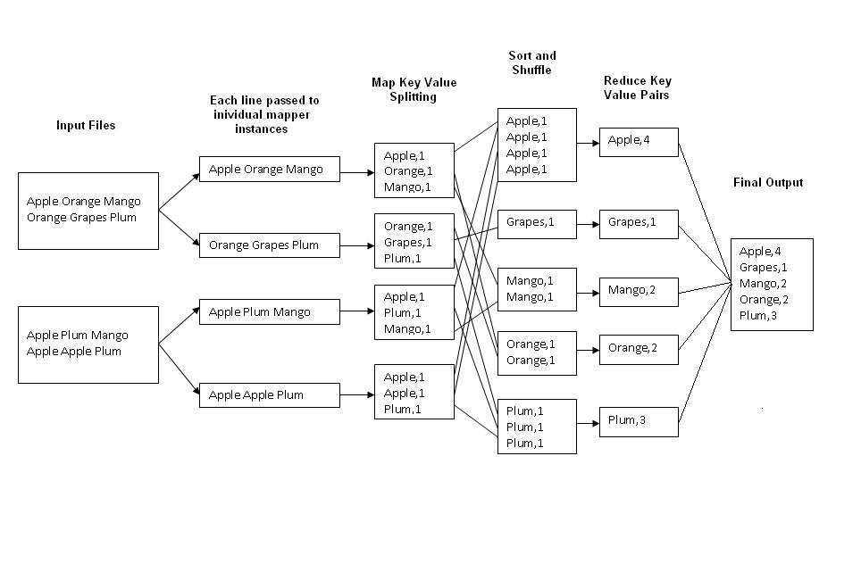
Example 1: Word Count
Job: Count the occurrences of each word in a data set
Map
Tasks
Reduce
Tasks

Slide 6
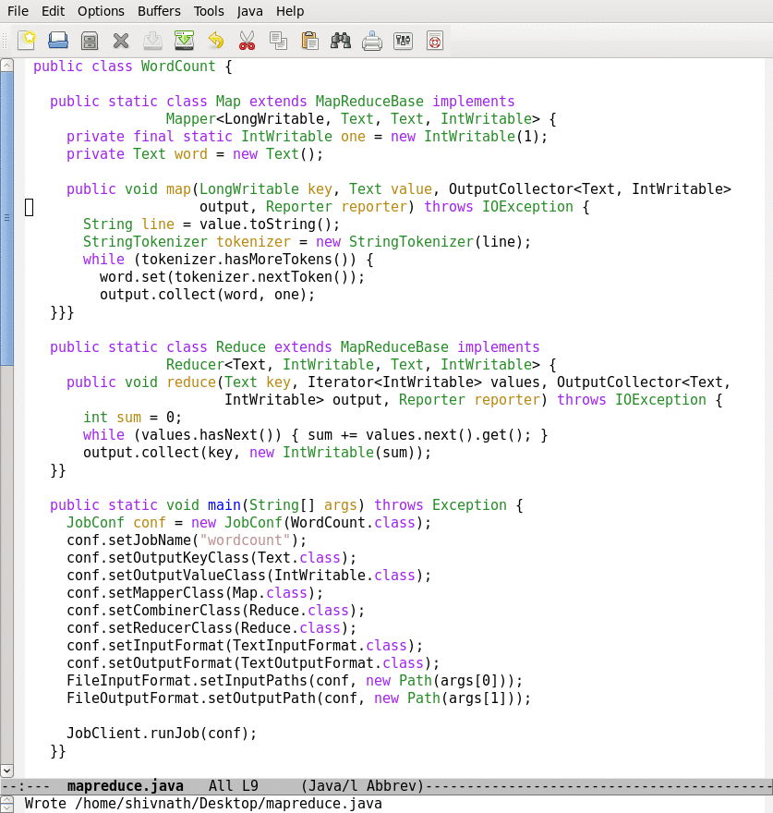
How it looks like in Java
Provide implementation for Hadoop’s Mapper abstract class
Map function
Provide implementation for Hadoop’s Reducer abstract class
Reduce function
Job configuration

Slide 7
Example 2: Color Count
Job: Count the number of each color in a data set
Input blocks on HDFS
Produces (k, v)
( , 1)
Shuffle & Sorting based on k
Consumes(k, [v])
( , [1,1,1,1,1,1..])
Produces(k’, v’)
( , 100)
Part0001
Part0002
Part0003
That’s the output file, it has 3 parts on probably 3 different machines

Slide 8
Example 3: Color Filter
Job: Select only the blue and the green colors
Each map task will select only the blue or green colors
No need for reduce phase
Input blocks on HDFS
Produces (k, v)
( , 1)
Write to HDFS
Part0001
Write to HDFS
Part0002
That’s the output file, it has 4 parts on probably 4 different machines
Write to HDFS
Part0003
Write to HDFS
Part0004

Slide 9
Optimization 1
In Color Count example, assume I know that the number of colors is small → can we optimize the map-side
 | 10
 | 5
 | 7
 | 20
Each map function can have a small main-memory hash table (color, count)
With each line, update the hash table and produce nothing
When done, report each color and its local count
Gain: Reduce the amount of shuffled/sorted data over the network
Q1: Where to build the hash table?
Q2: How to know when done?

Slide 10
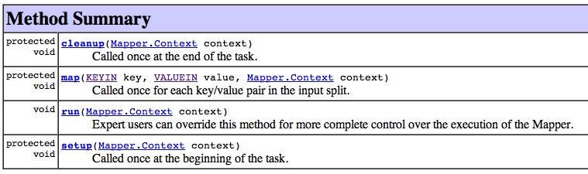
Inside the Mapper Class
Called once after all records (Here you can produce the output)
Called for each record
Called once before any record (Here you can build the hash table)
Reducer has similar functions…

Slide 11
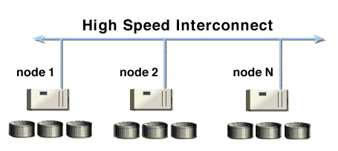
Optimization 2: Map-Combine-Reduce
What about partially aggregating the results from mappers on each machine
Mappers 1…3
Mappers 4…6
Mappers 7…9
A combiner is a reducer that runs on each machine to partially aggregate (that’s a user code) mappers’ outputs from this machine
Then, combiners output is shuffled/sorted for reducers

Slide 12
Tell Hadoop to use a Combiner
Not all jobs can use a combiner
Use a combiner

Slide 13
Optimizations 3: Speculative Execution
If one node is slow, it will slow the entire job
Speculative Execution: Hadoop automatically runs each task multiple times in parallel on different nodes
First one finishes, the others will be killed

Slide 14
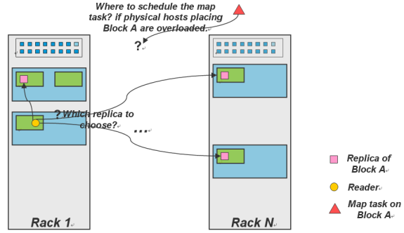
Optimizations 4: Locality
Locality: try to run the map code on the same machine that has the relevant data
If not possible, then machine in the same rack
Best effort, no guarantees

Slide 15
Translating DB Operations to Hadoop Jobs
Select (Filter) → Map-only job
Projection → Map-only job
Grouping and aggregation → Map-Reduce job
Duplicate Elimination → Map-Reduce job
Map (Key= hash code of the tuple, Value= tuple itself)
Join → Map-Reduce job

Slide 16
Joining Two Large Datasets: Re-Partition Join
Dataset A
Dataset B
Different join keys
Reducers perform the actual join
Reducer 1
Reducer 2
Reducer N
Shuffling and sorting over the network
Shuffling and Sorting Phase
- Each mapper processes one block (split)
- Each mapper produces the join key and the record pairs
Mapper 1
Mapper 2
Mapper 3
Mapper M+N
HDFS stores data blocks
(Replicas are not shown)

Slide 17
Joining Large Dataset (A) with Small Dataset (B) Broadcast/Replication Join
Dataset A
Dataset B
Different join keys
Every map task processes one block from A and the entire B
Every map task performs the join (MapOnly job)
Avoid the shuffling and reduce expensive phases
Mapper 1
Mapper 2
Mapper N
HDFS stores data blocks
(Replicas are not shown)

Slide 18
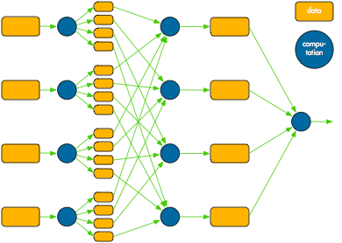
Hadoop Fault Tolerance
Intermediate data between mappers and reducers are materialized to simple & straightforward fault tolerance
What if a task fails (map or reduce)?
Tasktracker detects the failure
Sends message to the jobtracker
Jobtracker re-schedules the task
What if a datanode fails?
Both namenode and jobtracker detect the failure
All tasks on the failed node are re-scheduled
Namenode replicates the users’ data to another node
What if a namenode or jobtracker fails?
The entire cluster is down
Intermediate data
(materialized)

Slide 19
More About Execution Phases

Slide 20
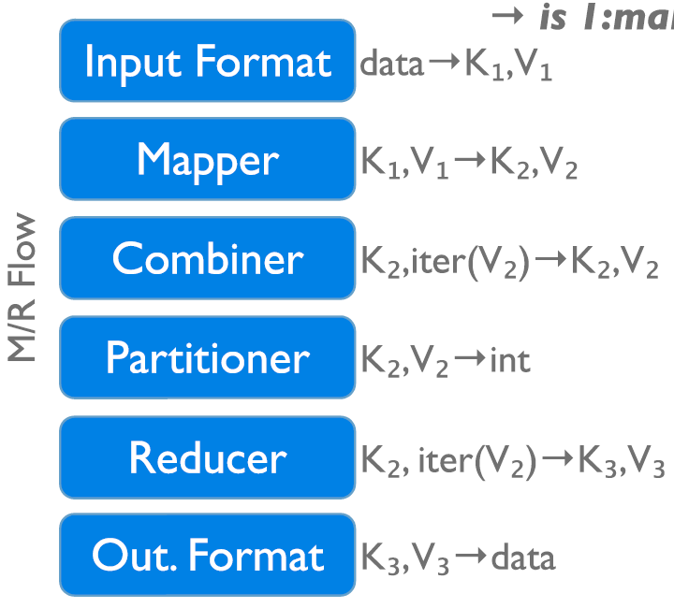
Execution Phases
InputFormat
Map function
Partitioner
Sorting & Merging
Combiner
Shuffling
Merging
Reduce function
OutputFormat

Slide 21
Reminder about Covered Phases
Job: Count the number of each color in a data set
Input blocks on HDFS
Produces (k, v)
( , 1)
Shuffle & Sorting based on k
Consumes(k, [v])
( , [1,1,1,1,1,1..])
Produces(k’, v’)
( , 100)
Part0001
Part0002
Part0003
That’s the output file, it has 3 parts on probably 3 different machines

Slide 22
Partitioners
The output of the mappers need to be partitioned
# of partitions = # of reducers
The same key in all mappers must go to the same partition (and hence same reducer)
Default partitioning is hash-based
Users can customize it as they need

Slide 23
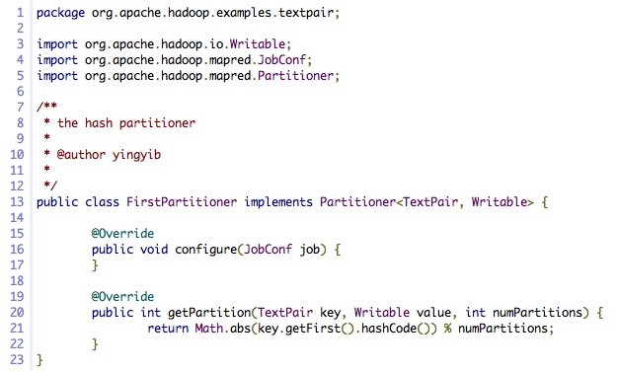
Customized Partitioner
Returns a partition Id

Slide 24
Optimization: Balance the Load among Reducers
Assume we have N reducers
Many keys {k1, k2, …, Km}
Distribution is skew
K1 and K2 have many records
Send K1 to Reducer 1
Send K2 to Reducer 2
K3, K5
K7, K10, K20
Rest are hash-based
…..
…..

Slide 25
Input/Output Formats
Hadoop’s data model ⬅ Any data in any format will fit
Text, binary, in a certain structure
How Hadoop understands and reads the data ??
The input format is the piece of code that understands the data and how to reads it
Hadoop has several built-in input formats to use
Text files, binary sequence files

Slide 26
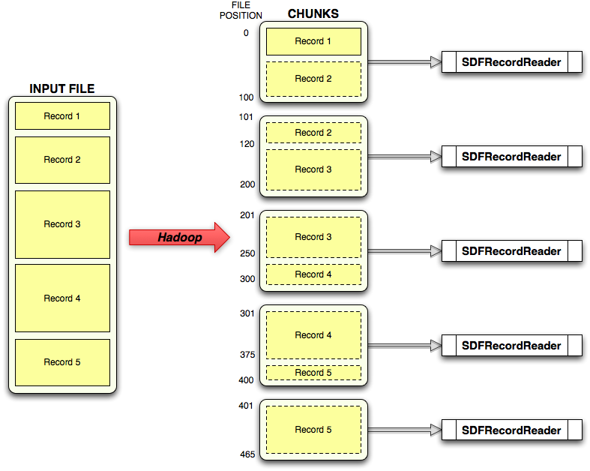
Input Formats
Record reader reads bytes and converts them to records

Slide 27
Tell Hadoop which Input/Output Formats
Define the formats

Slide 28
We Covered All Execution Phases
InputFormat
Map function
Partitioner
Sorting & Merging
Combiner
Shuffling
Merging
Reduce function
OutputFormat

Slide 29

Any Questions So Far…

Slide 30
More on HDFS

Slide 31
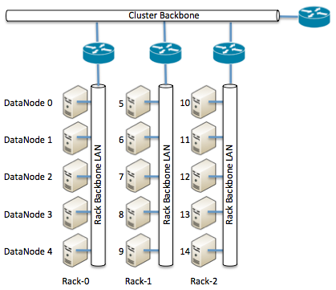
HDFS and Placement Policy
Default Placement Policy
First copy is written to the node creating the file (write affinity)
Second copy is written to a data node within the same rack
Third copy is written to a data node in a different rack
Objective: load balancing & fault tolerance
Rack-aware replica placement

Slide 32
Safemode Startup
On startup Namenode enters Safemode (few seconds).
Each DataNode checks in with Heartbeat and BlockReport.
Namenode verifies that each block has acceptable number of replicas
If things are fine ➔ Namenode exits Safemode
If some blocks are under replicated
Replicate these blocks to other Datanodes
Then, exit safemode

Slide 33
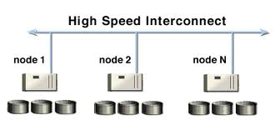
The Communication Protocol
All HDFS communication protocols are layered on top of the TCP/IP protocol
A client establishes a connection to a configurable TCP port on the Namenode machine. It talks ClientProtocol with the Namenode
The Datanodes talk to the Namenode using Datanode protocol
File transfers are done directly between datanodes
Does not go though the namenode

Slide 34
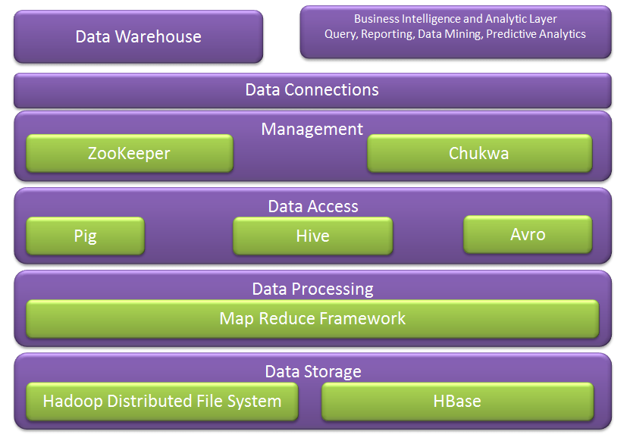
Hadoop Ecosystem
Next week we cover more of these
We covered these

Slide 35
Configuration
Several files control Hadoop’s cluster configurations
Mapred-site.xml: map-reduce parameters
Hdfs-site.xml: HDFS parameters
Matsers: Which node(s) are the master ones
Slaves: which nodes are the slaves
Hadoop has around 190 parameters
Mostly 10-20 are the effective ones

Slide 36
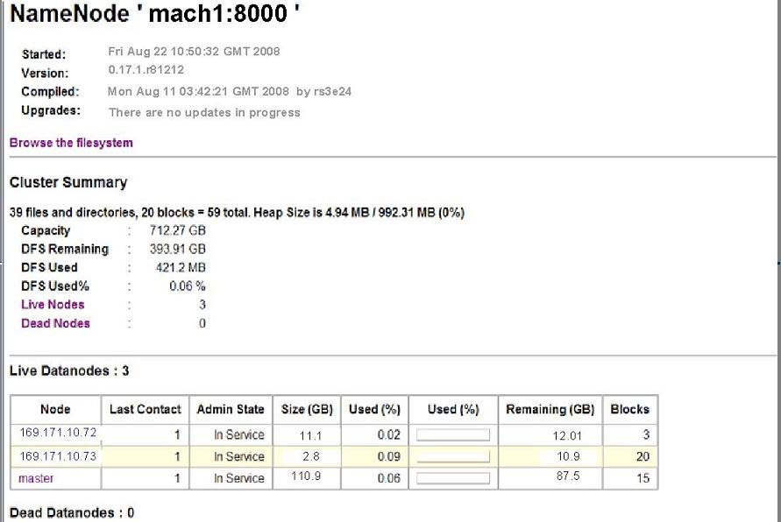
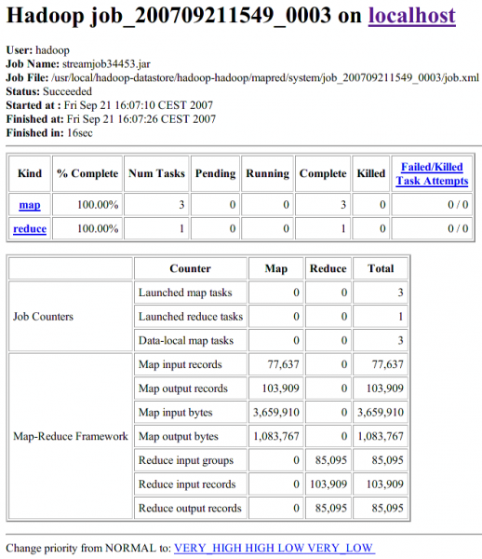
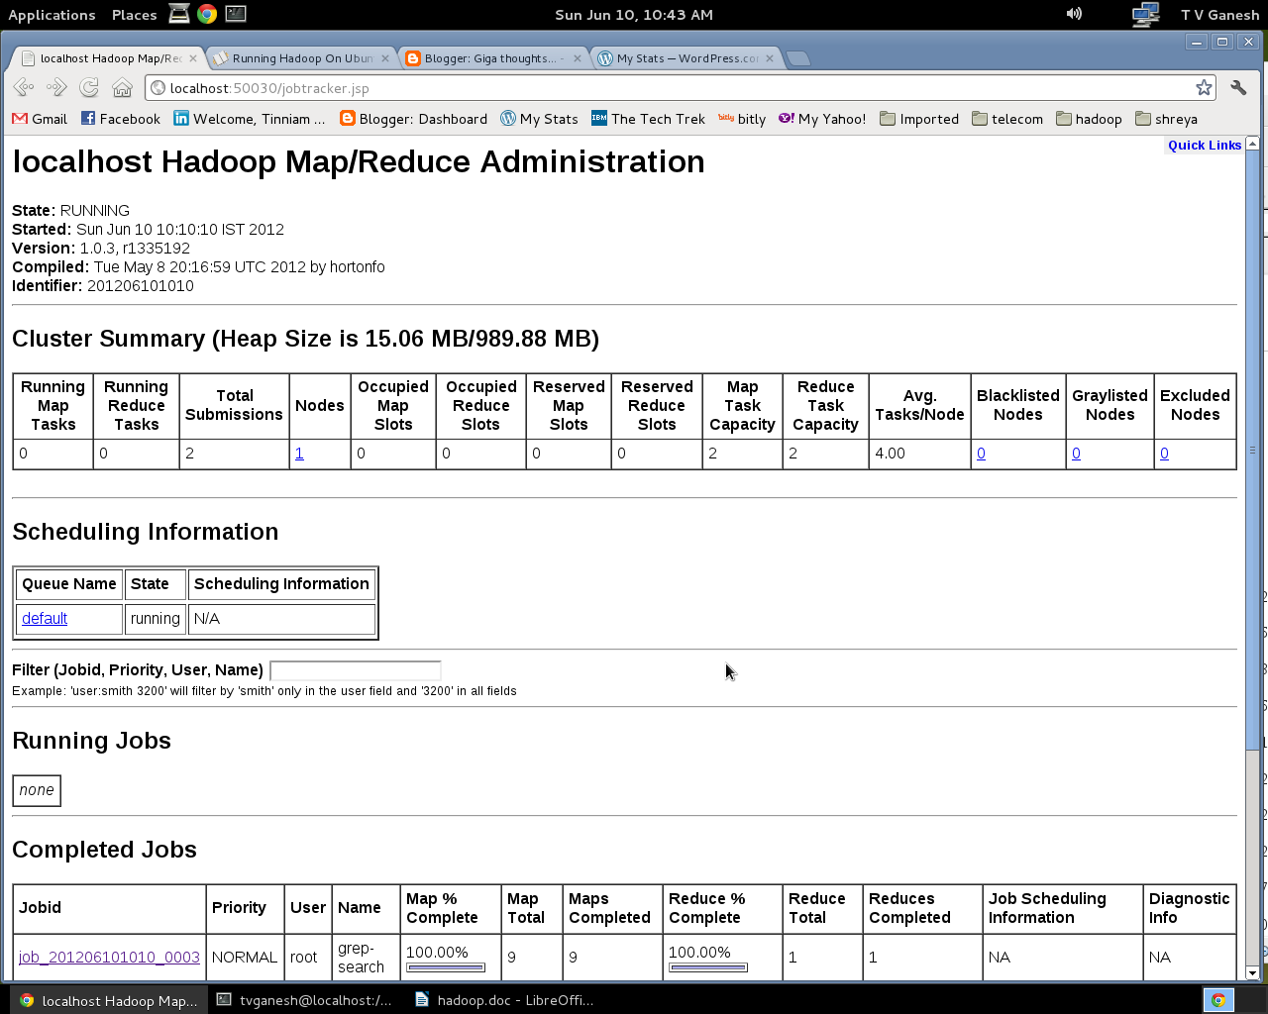
Web Interface
HDFS Interface
MapReduce Interface

